Slide 1

Information Propagation Model in a Social Network
Karine Megerdoomian
GMU CSS 899
Fall 2013

Slide 2
Background
Background
  Two-step flow of communication (Lazarsfeld et al 1968)
    ideas flow from mass media to opinion leaders, then to the wider population
  Two-step flow observed in Twitter networks (Wu et al 2011)
Research Questions
  Can we detect the two-step flow of communication in a social network model (e.g., Twitter, blogs)?
  What is the effect of various network properties and node metrics on information flow?

Slide 3
Methods and Data
Methods
  Develop a stylized model of information propagation in a social network
    Generate a social network with initial information holder nodes
    Represent the diffusion of the information within the network
    Similar to disease propagation models (except no one recovers)
  User can modify network properties
    Network type: preferential vs. random attachment
    Edge type: directed vs. undirected links
    Role of information holder: centrality measures (degree, betweenness, closeness, eigenvector)
    Have not considered weights on edges or resistance from nodes (e.g., previous contrasting ideology)
Data
  Abstract model - no attempt to correlate with real social network data (yet!)
  Note: Twitter is a preferential attachment, directed network → so it’s possible to test those properties specifically

Slide 4
Previous Models
Preferential attachment model generates graph
Diffusion in randomly and preferentially grown networks – extension by Lada Adamic
Diffusion Competition: a model of contagion for opinion formation (written as a two-player game)
  Considers initial position of opinionated node
  Complex version: you need to hear from at least two friends before adopting an opinion
These models do not consider the role of centrality measures in the diffusion

Slide 5
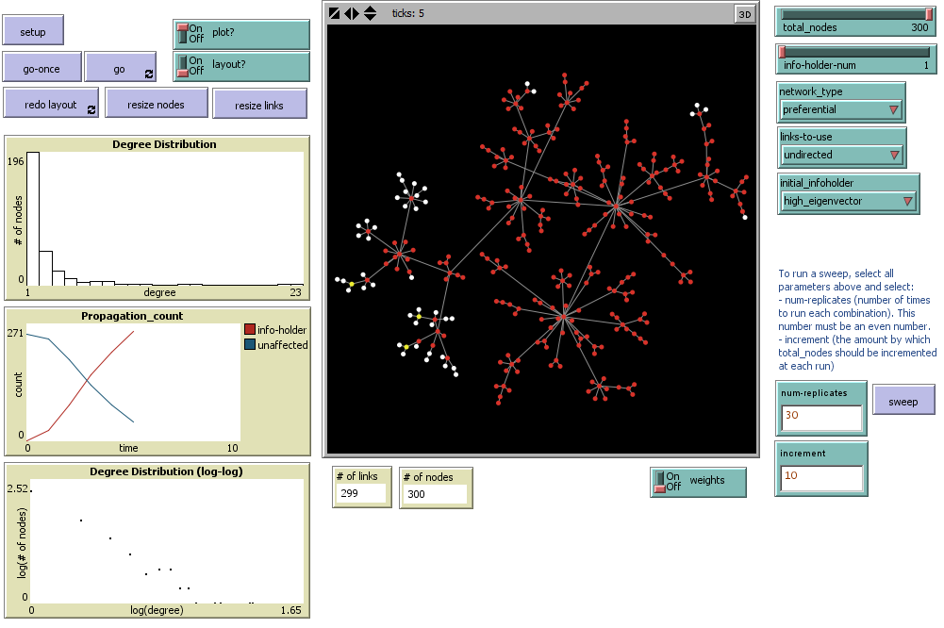

Slide 6
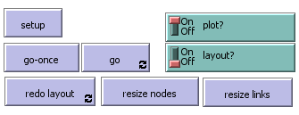
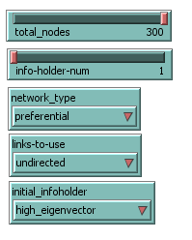
Model Overview: Network properties
Select all parameters:
  Size of network (number of nodes)
  Preferential or random attachment graph
  Directed or undirected links
  How many nodes (persons) should be holding the information initially?
  Should information holder(s) appear randomly in the graph or based on centrality measures?

Slide 7
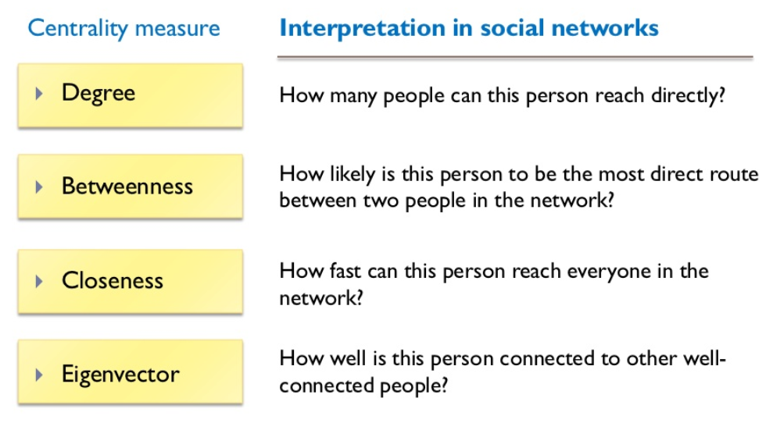
source: Cheliotis (2010)

Slide 8
Netlogo NW Extension
Betweenness centrality for a turtle
  take every other possible pairs of turtles and, for each pair, calculate the proportion of shortest paths between members of the pair that passes through the current turtle. The betweenness centrality of a turtle is the sum of these.
Closeness centrality for a turtle
  is defined as the inverse of the sum of its distances to all other turtles.
Eigenvector centrality of a turtle
  the proportion of time that an agent forever “walking” at random on the network would spend on this node. In practice, turtles that are connected to a lot of other turtles that are themselves well-connected (and so on) have a higher Eigenvector centrality score.
  Eigenvector centrality is only defined for connected networks, and will report false for disconnected graphs.

Slide 9
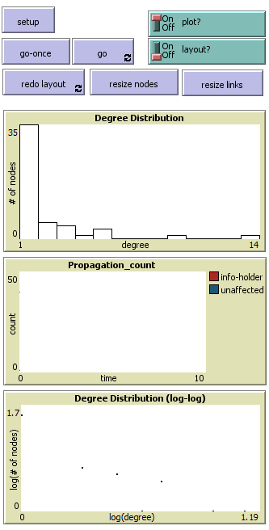
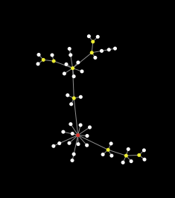
Model Overview: Generate graph
Generates graph and plots the degree distribution
  Preferential network

Slide 10
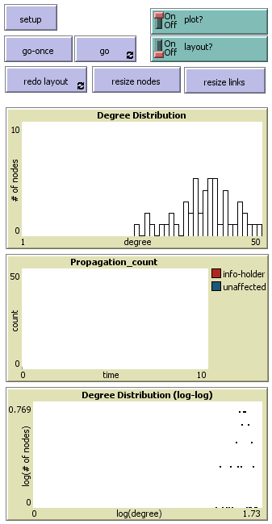
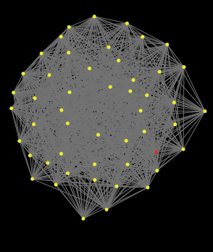
Model Overview: Generate graph
Generates graph and plots the degree distribution
  Preferential network
  Random network
Yellow nodes mark high degree centrality

Slide 11
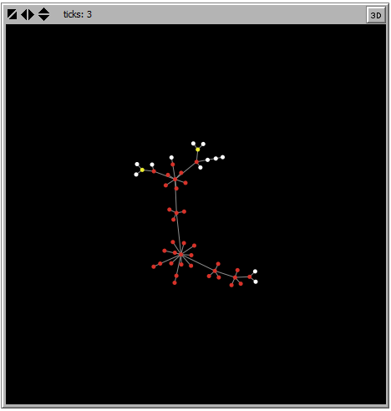
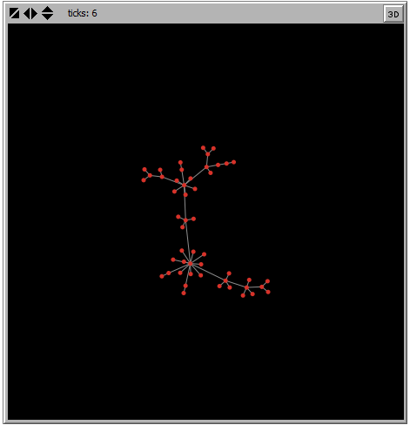
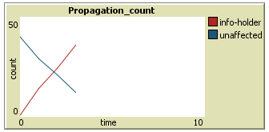
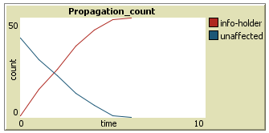
Model Overview: Information spread
Assumption: If you link to a node, you’ll get the information from that node.

Slide 12
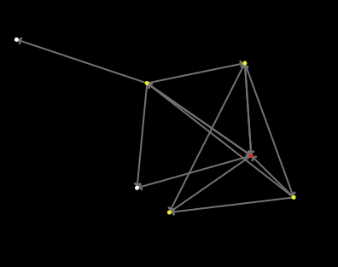
Directed Graphs
The direction of linking plays a role in information diffusion
  A is information holder
  If B links to A, then B
  ➔ B gets info from A
  If A links to C, C does not get info from A
A
C
B

Slide 13
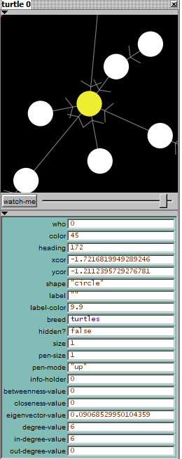
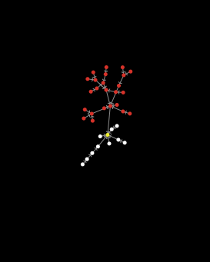
Directed Graphs
Information diffusion can be blocked

Slide 14
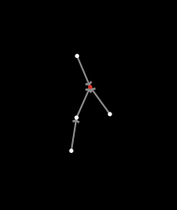
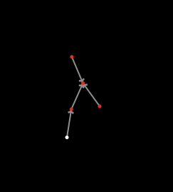
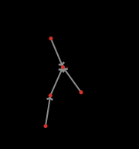
Sample Directed Graph Spread
Setup
Tick 1
Tick 2

Slide 15
Modeling Approach
Run baselines with randomly generated information holder in the network
Combinations include:
  Random graph + directed links
  Random graph + undirected links
  Preferential graph + directed links
  Preferential graph + undirected links
Change initial position of information holder based on centrality measure
See if centrality value affects the time it takes to spread the information and the number of nodes that remain unaffected by the information

Slide 16
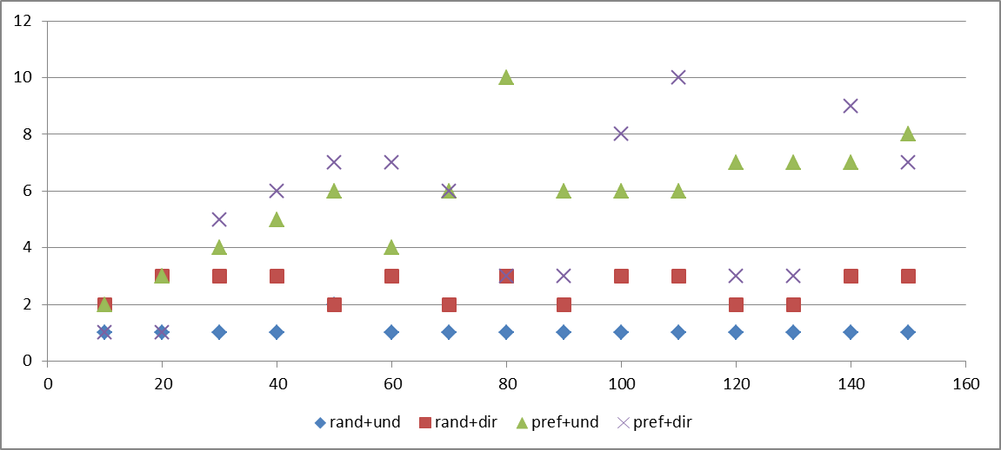
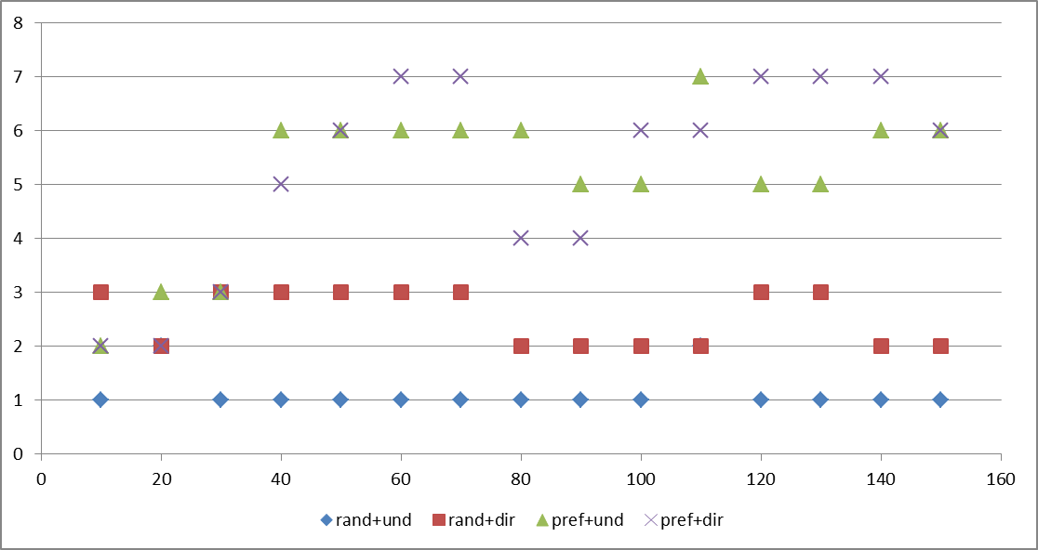
Diffusion Time
Info-holder = high-degree
Preferential attachment network shows direct correlation of diffusion time with network size
In general, random networks show faster diffusion spread
Note: runs with only one initial information holder
Info-holder = high-betweenness

Slide 17
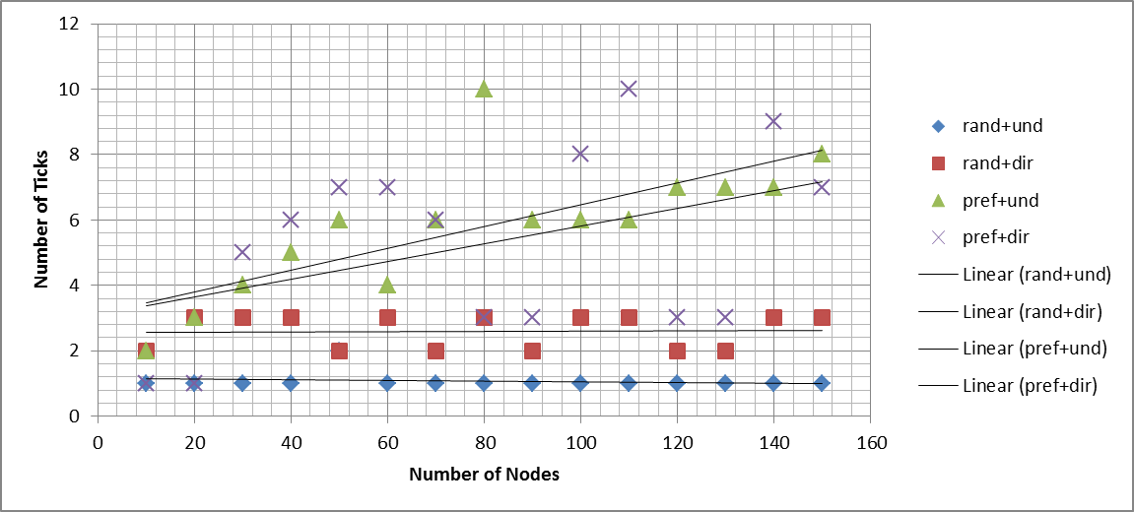
Diffusion Time (cont.)
Info-holder = high-degree

Slide 18
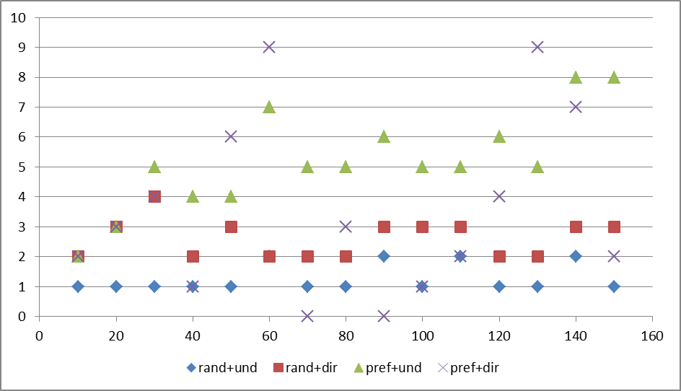
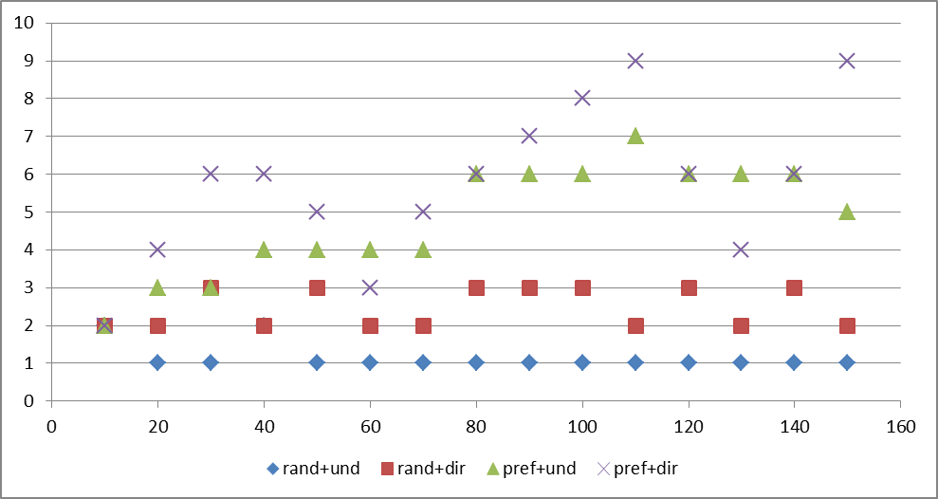
Diffusion Time (cont.)
Info-holder = high-closeness
Info-holder = high-eigenvector

Slide 19
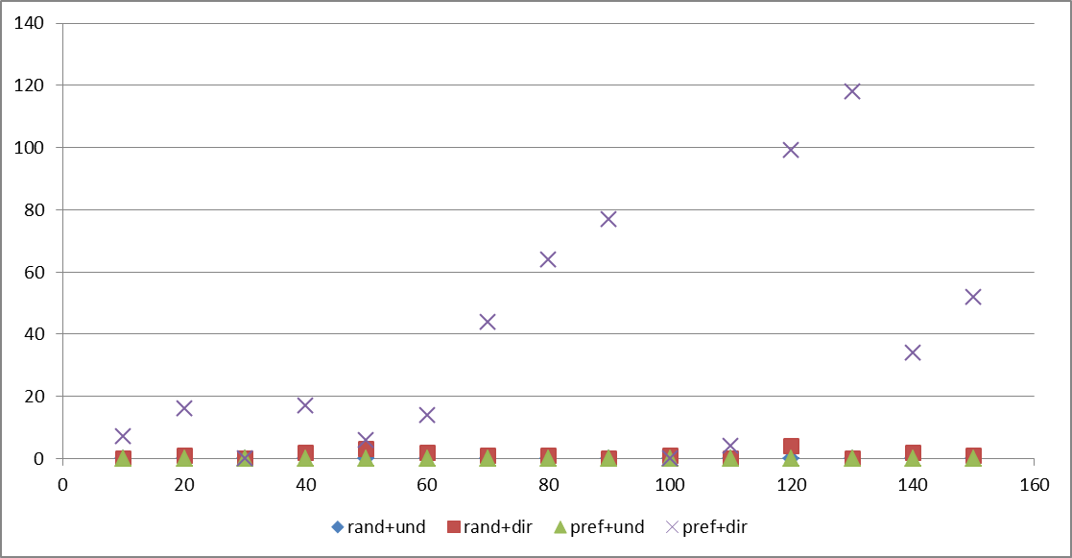
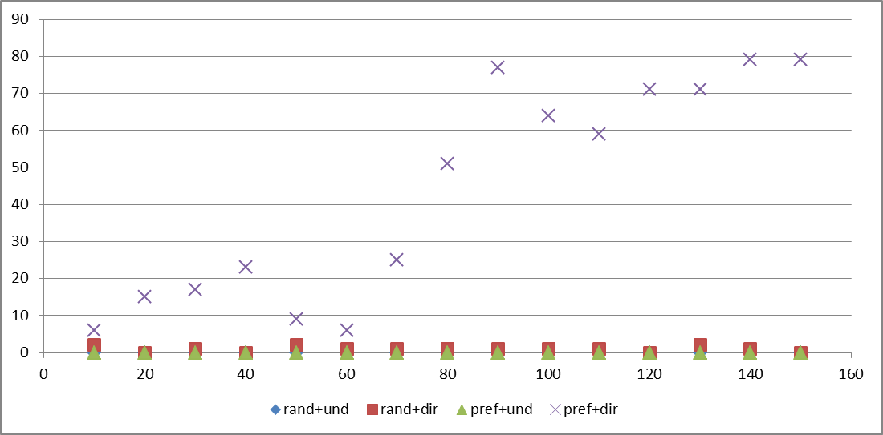
Success of Diffusion
Info-holder = high-degree
In most combinations, the information is successfully spread to the whole network
Preferred attachment network with directed links is the most resistant to information diffusion
Info-holder = high-betweenness

Slide 20
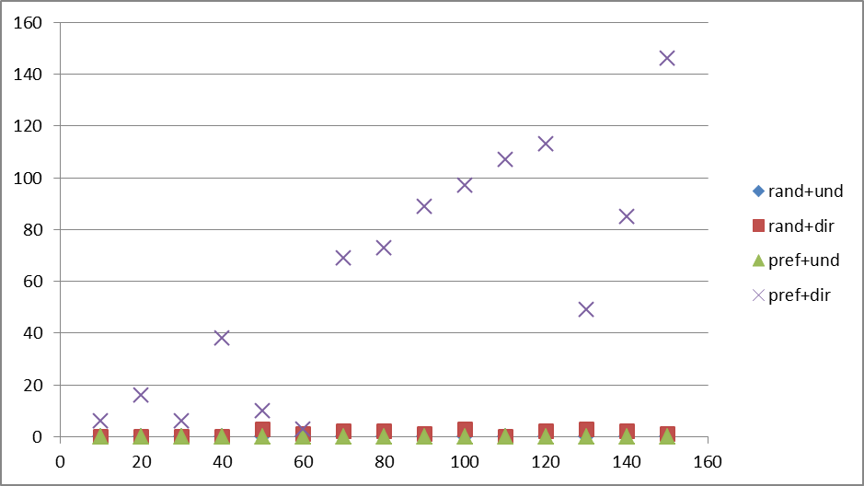
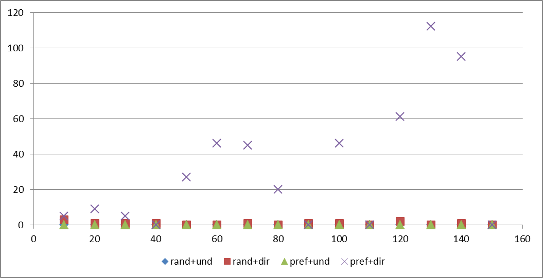
Success of Diffusion (cont.)
Info-holder = high-closeness
Info-holder = high-eigenvector

Slide 21
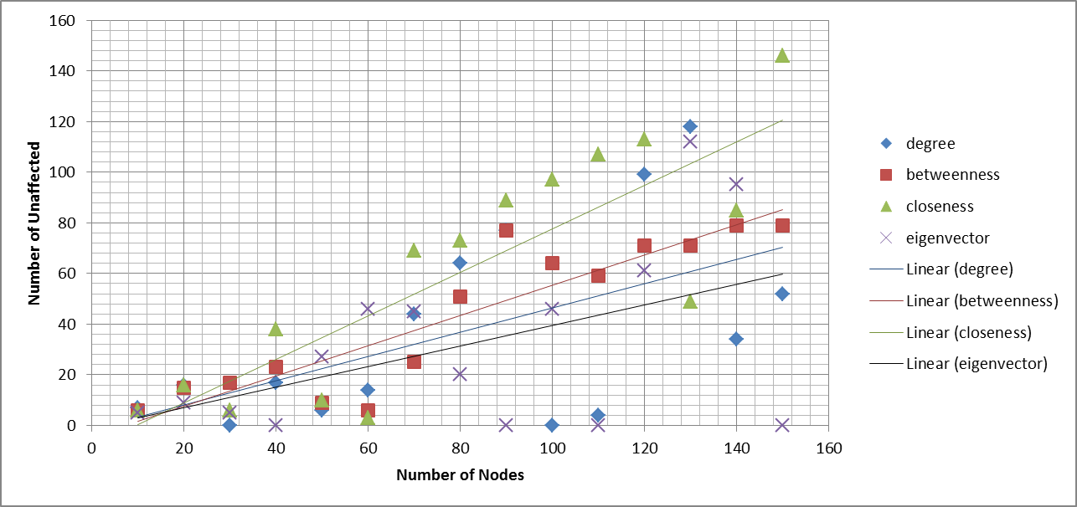
Centrality and Diffusion Success
Preferential directed graphs

Slide 22
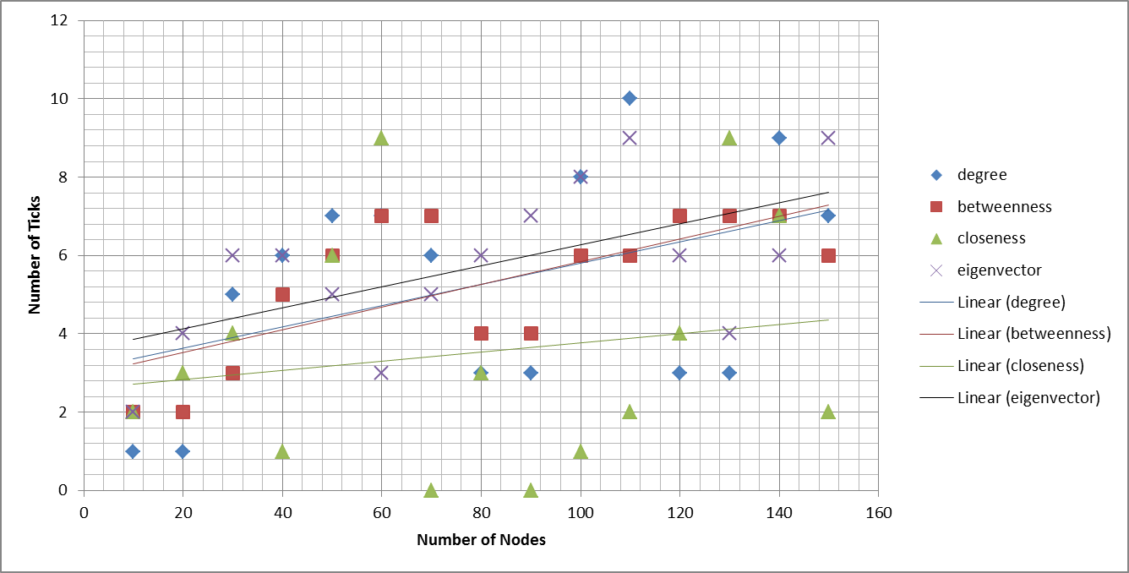
Centrality and Diffusion Time
Preferential directed graphs

Slide 23
Conclusions and Future Work
Conclusions
  Model shows the effect of network properties and centrality measures on the diffusion of information in a social network
    Preferential networks take longer to spread the information
    Preferential directed graphs are most resistant to information flow
    If information starts in a high-eigenvector node, it has more chance of spreading in the network (?)
  Two-step information flow seems to hold true for random networks, but not for preferential networks
Future Work
  Get away from the assumption that if you link, you adopt info:
    Adding weights to edges (need a threshold to adopt info)
    Adding prior ideology (node may be more resistant to certain types of info than others) – perhaps use clustering?
  Load data from a real Twitter network with centrality metrics and test against transfer of topic or opinion

